Slide 1
DO modeling thoughts
10 Sep 21

Slide 2
Recap of what I have done so far
Oxygen demand was strongly influenced by temperature and the rate of oxygenation
Calculated oxygen demand in “intervals” from 2013–2019
Tried to constrain Arrhenius parameters
Erroneous results (theta < 1, etc.)
Near term forecasting with data assimilation to constrain parameters. Wrote a draft of a paper about using forecasting to analyze the drivers of hypo DO.
Parameter evolution is difficult to interpret (differences between years, etc.). Forecasting approach is overly complicated: driver uncertainty complicates results, predictions are not independent tests due to data assimilation.
Switched back to modeling (with the goal of analyzing the relative importance of temp and DO as drivers of DO). Have some preliminary results, but nothing pops out as super compelling

Slide 3
Ideas moving forward
Could keep moving with the DO modeling (temp/DO) story
If there isn’t enough of a story with the DO data, maybe it would be interesting to draw in GHG data and analyze how/when the drivers of DO and GHGs are similar/different (and how these differences in drivers then influence RQ)

Slide 4
Initial results
DO modeling results

Slide 5
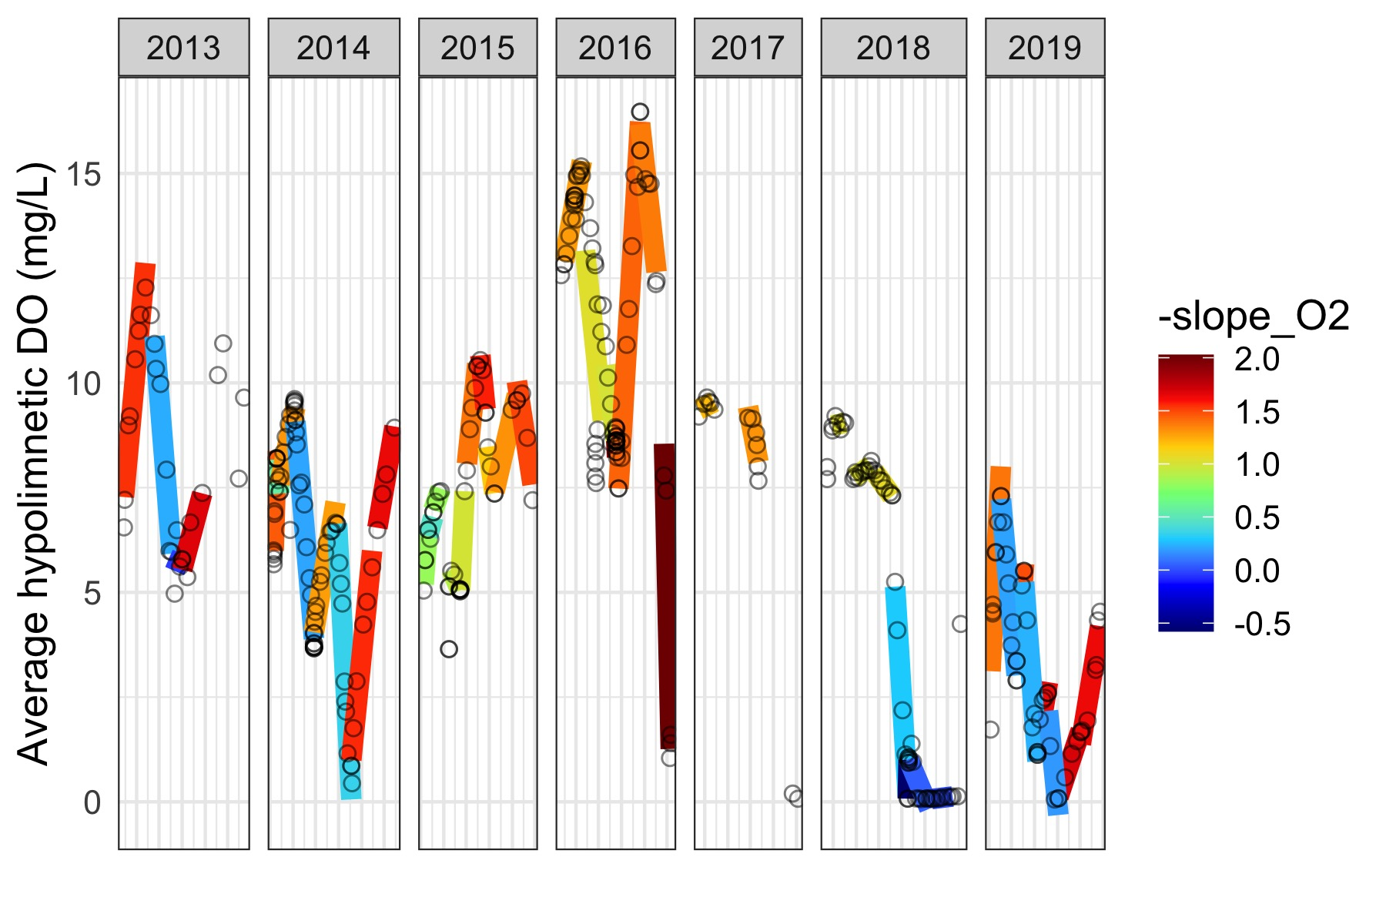
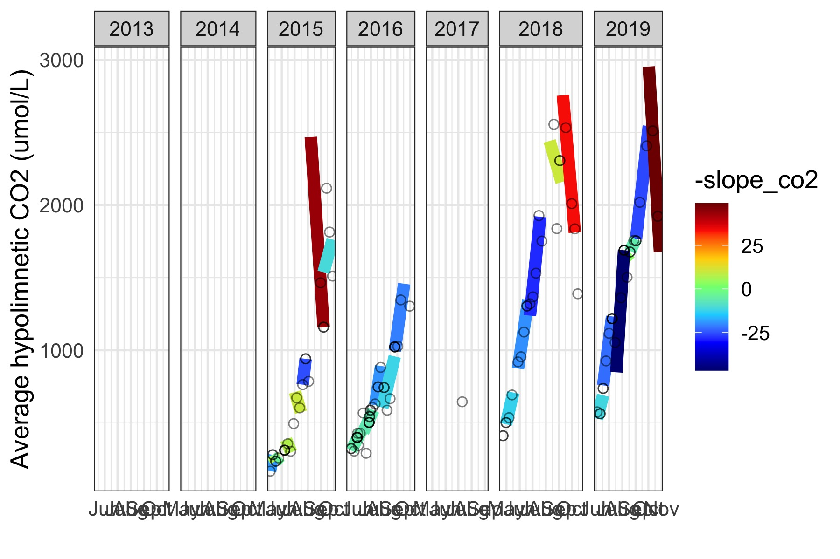
Intervals

Slide 6
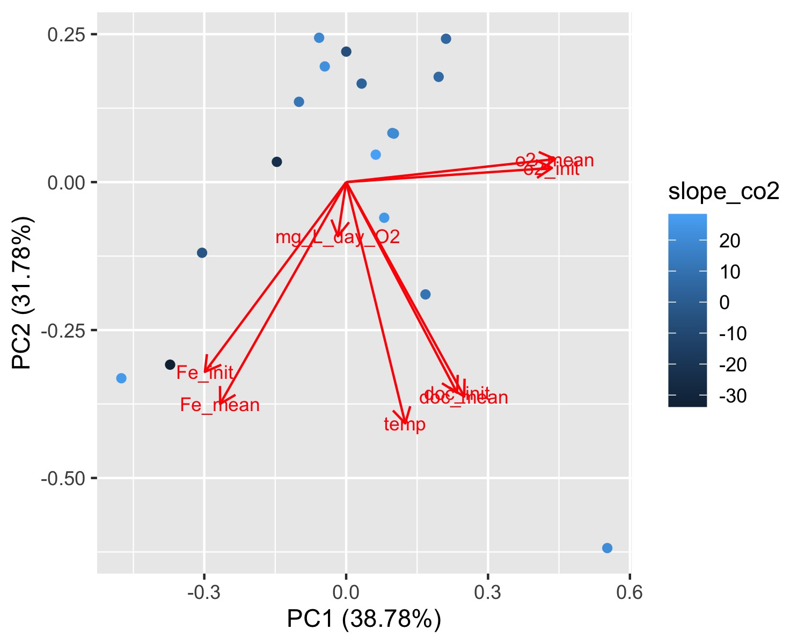
Drivers

Slide 7
Best models for predicting DO and CO2
DO: temp (C), O2 added (mg/L/day)
CO2: temp (C), O2 (mean), O2 (init), O2 added (mg/L/day), DOC (mean), DOC (init), Fe (init), Fe (mean)
and many others within 2 AIC
RQ: temp (C), O2 (mean), O2 (init), O2 added (mg/L/day), DOC (mean), DOC (init), Fe (init), Fe (mean)
and many others within 2 AIC

